Slide 1
Curriculum Vitae (CV) Examples

Slide 2
EDUCATION
Good Example
Bad Example
Need Start and End Date
MM/YYYY Format

Slide 3
FELLOWSHIP/INTERNSHIP
Good Example
Bad Example
Need to be in
MM/YYYY Format

Slide 4
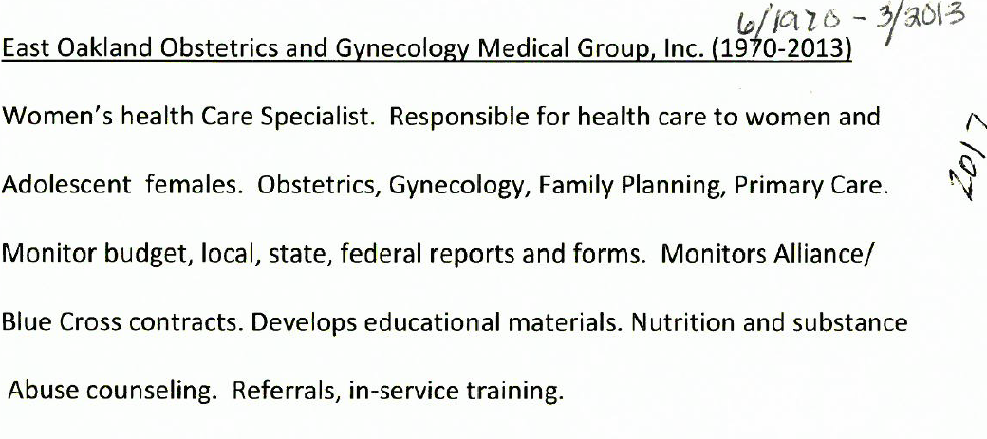
WORK EXPERIENCE
Good Examples
Date in MM/YYYY Format
Reason for Departure
Explanation of employment gap

Slide 5
WORK EXPERIENCE
Bad Examples
Hard to read
What is the To Date? Is this a current position?
Need to be in
MM/YYYY Format

Slide 6
CV Checklist
Resume should include provider’s first and last name
Resume reflects a minimum of 10 years of relevant work experience
If there is a non-employment gap of 3 months or more within the last 10 years, provider must provide an explanation.
Dates are in the Month + Year format (MM/YYYY )
Education has start date and end date
Work experience has start date and end date (if applicable)
If work experience has end date, provider must give reason for departure
Verify “current” work experience on CV is still current
If Advanced Practice Professionals (APPs) and MD/DOs is board certified, provide documentation and
Initial Board Certification Date
Board Certification Expiration Date
Last Board Recertification Date (if available)

